Slide 1
Human Resources Analytics
Ritesh Kumar Vangapalli

Slide 2
Introduction
Description : Why are our best and most experienced employees leaving prematurely? Have fun with this database and try to predict which valuable employees will leave next. Fields in the dataset include:
Employee satisfaction level
Last evaluation
Number of projects
Average monthly hours
Time spent at the company
Whether they have had a work accident
Whether they have had a promotion in the last 5 years
Sales
Salary
Whether the employee has left

Slide 3
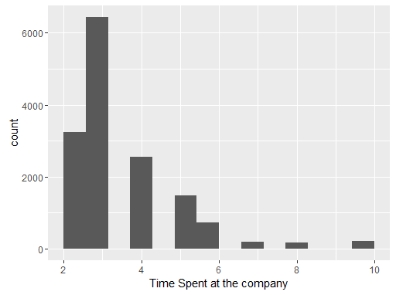
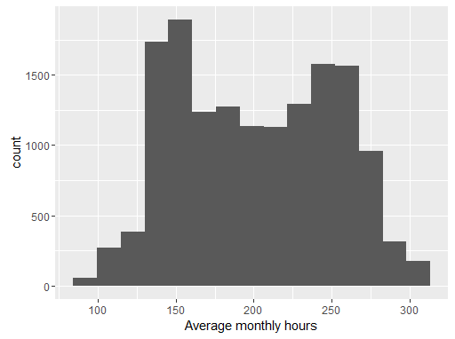
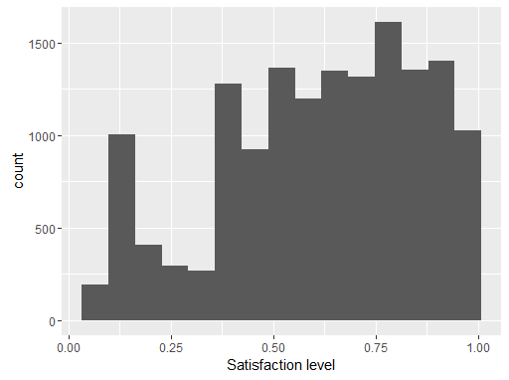
Explanatory Analysis

Slide 4
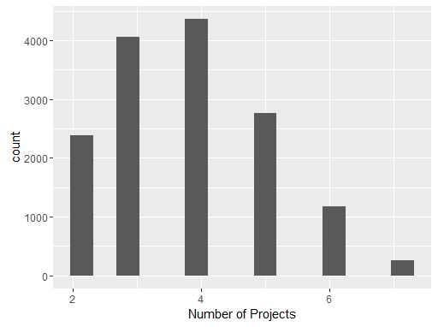
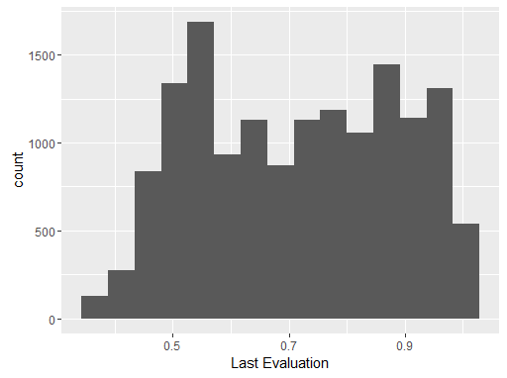
Explanatory Analysis

Slide 5
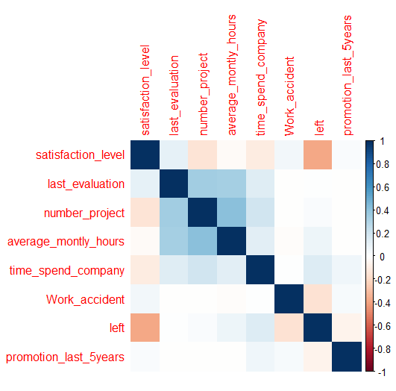
Correlation Analysis

Slide 6
PS : Why are the best and most experienced employees leaving prematurely ?
So let’s define who are the best and most experienced employees..
(above average)
Last Evaluation >= 0.75
time_spend_company >= 4
number_project > 5
About 1950 people

Slide 7
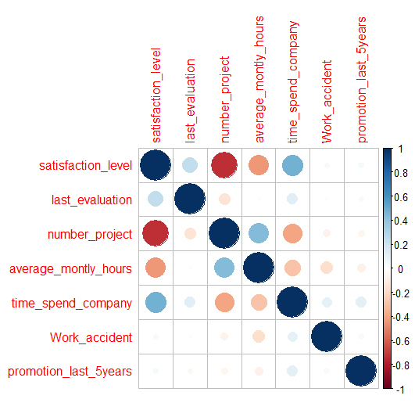
Correlation Analysis
(of good people)

Slide 8
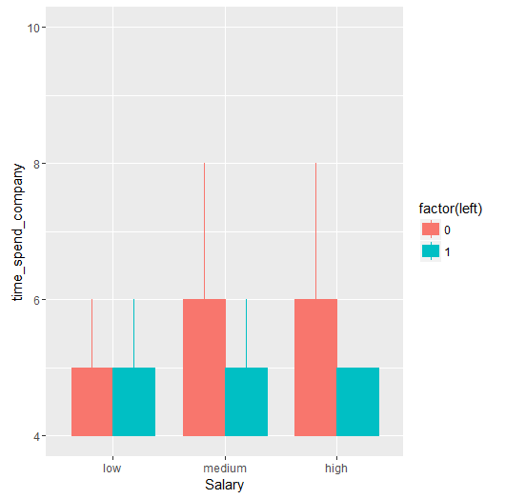
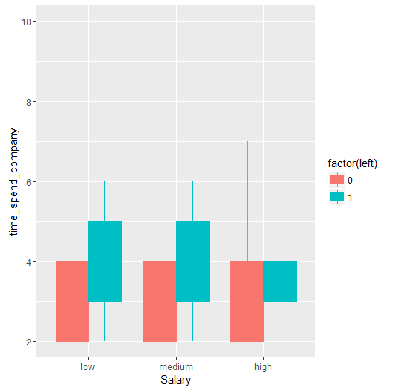
Boxplots (Time Spent in Company vs Salary)
On Full Data On the Good People data

Slide 9
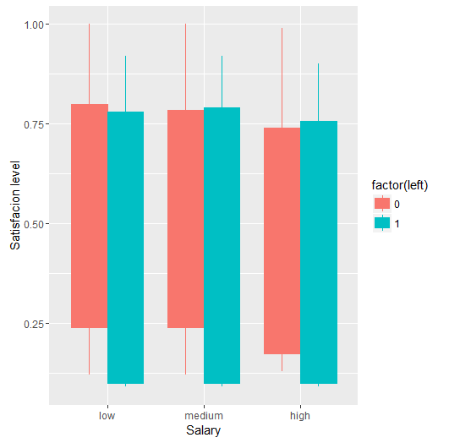
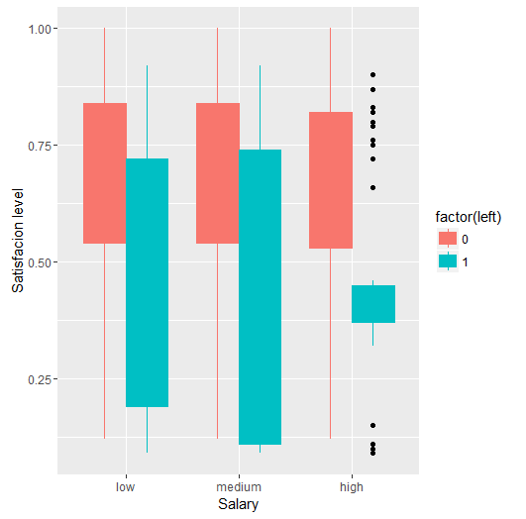
Boxplots (Satisfaction levels vs Salary)
On Full Data On the Good People data

Slide 10
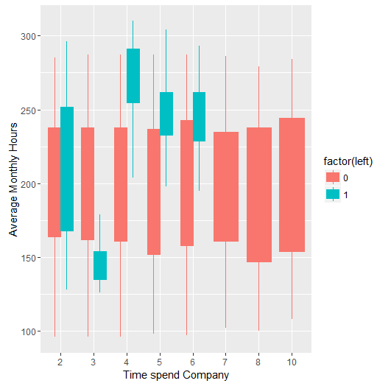
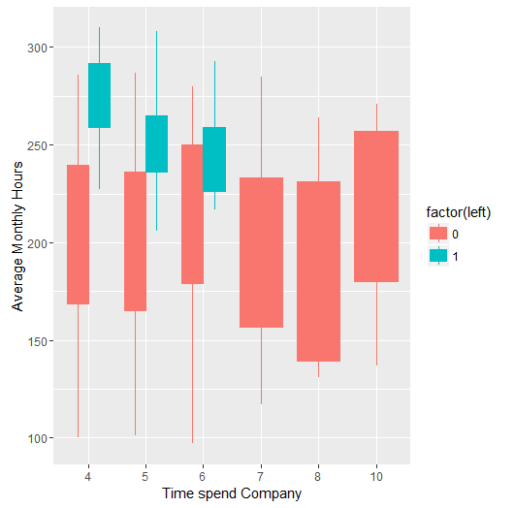
Boxplots (Average Monthly Hours vs Time spent Company)
On Full Data On the Good People data

Slide 11
Observations
From Boxplot 1(Time Spent in Company vs Salary) : In the good people data we find that the people leaving are more experienced (i.e. higher time spent in company on average) in the low and medium salary class.
From Boxplot 2 (Satisfaction levels vs Salary): In the good people data we find that the average satisfaction of the employees who left is lower than who haven’t left
From Boxplot 3 (Average Monthly Hours vs Time spent Company): In the good people data we find that the people leaving have spent more hours at work

Slide 12
Conclusion
Common traits of Good people leaving : Experienced Very low satisfaction levels Spend more time at work | Possible Reasons for people leaving: Experienced people may not be finding any challenges in work. Hence they leave. Work to Pay ratio may be high (because we find clear correlation only in low and medium salary ranges)

Slide 13
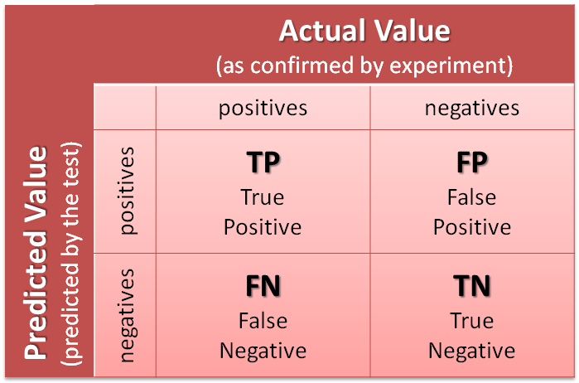
Now let us see how different Models have performed
2260 | 7
53 | 679
C5.0 Tree
Logistic Regression
SVM
Random Forest
AdaBoost
2139 | 478
128 | 254
2168 | 540
99 | 192
2264 | 23
3 | 709
2263 | 21
4 | 711
2263 | 25
4 | 707

Slide 14
Summary of Model Performance
 | Accuracy | Precision | Recall | AUC
C5.0 Tree | 0.98 | 0.9969 | 0.9771 | 0.9623
Logistic Regression | 0.7979 | 0.8173 | 0.9435 | 0.6453
SVM | 0.7869 | 0.8006 | 0.9563 | 0.6093
Random Forest | 0.9913 | 0.9899 | 0.9987 | 0.9836
AdaBoost | 0.9903 | 0.9891 | 0.9982 | 0.982

Slide 15
Clearly, we can see that Random Forests and Adaboost are doing better than other models
Next :
Feature Selection

Slide 16
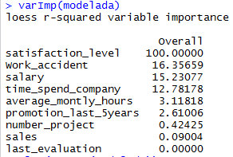
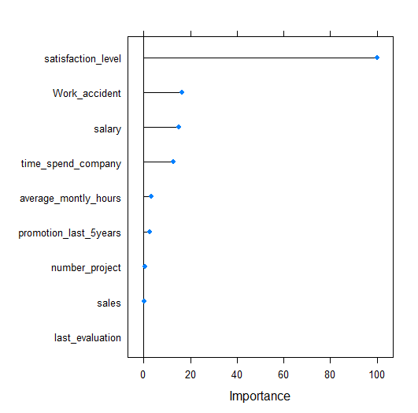
Adaboost
Parameters Removed :
Last_evaluation
Sales
Parameters Used in final Model :
Satisfaction_level
Number_project
Average_monthly_hours
Time_spend_company
Work_accident
Salary
promotion_last_5years

Slide 17
Final Model (Using Adaboost)
Parameters Used :
promotion_last_5years Actual Value
Satisfaction_level
Number_project
Average_monthly_hours
Time_spend_company
Work_accident
Salary
2248 | 29
19 | 703
 | Accuracy | Precision | Recall | AUC
Final Model | 0.984 | 0.9873 | 0.9916 | 0.976

Slide 18
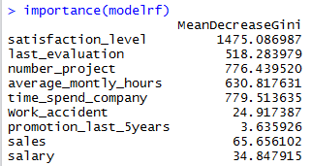
Random Forest
Parameters Removed :
promotion_last_5years
Work_accident
Salary
Sales
Parameters Used in final Model :
Satisfaction_level
Last_evaluation
Number_project
Average_monthly_hours
time_spend_company

Slide 19
Final Model (Using Random Forest)
Parameters Used :
Last_evaluation Actual Value
Number_project
Average_monthly_hours
time_spend_company
2263 | 25
4 | 707
 | Accuracy | Precision | Recall | AUC
Final Model | 0.9917 | 0.9908 | 0.9982 | 0.9838

Slide 20
Now , Let’s repeat the entire process with the good people data as our aim is to find why the good people are leaving and build a model to predict if they will be leaving.

Slide 21
Now let us see how different Models have performed
C5.0 Tree
Logistic Regression
SVM
Random Forest
Adaboost
46 | 10
6 | 247
36 | 6
20 | 247
37 | 9
19 | 244
56 | 0
0 | 253
56 | 0
0 | 253

Slide 22
Summary of Model Performance
 | Accuracy | Precision | Recall | AUC
C5.0 | 0.9482 | 0.8214 | 0.8846 | 0.8989
Logistic Regression | 0.9159 | 0.8571 | 0.6429 | 0.8096
SVM | 0.9094 | 0.8043 | 0.6607 | 0.8126
Random Forest | 1 | 1 | 1 | 1
Adaboost | 1 | 1 | 1 | 1

Slide 23
Parameter Selection
By following the same procedure as discussed we get :
A random Forest model with all parameters except promotion_last_5years, Work_accident, Salary and Sales and an Adaboost model with all parameters except Last_evaluation and Sales. The final result doesn’t change. Any other changes in the parameters causes a significant decrease in the performance measures.
 | Accuracy | Precision | Recall | AUC
Final Model | 1 | 1 | 1 | 1

